Slide 1
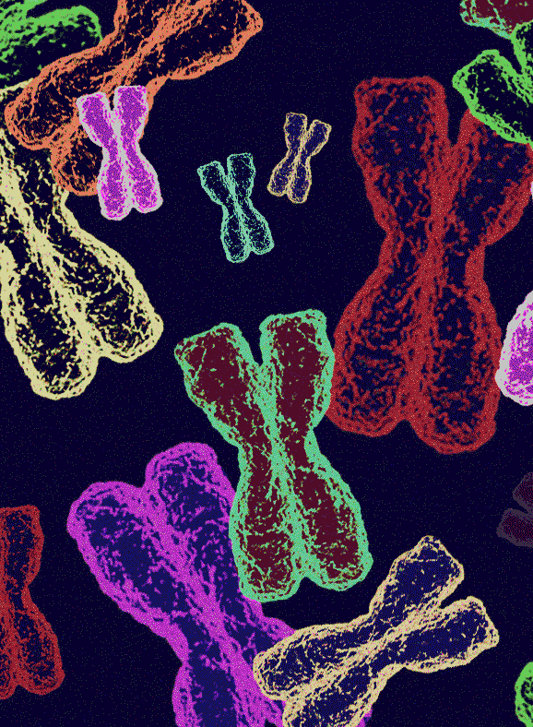
Types of Inheritance:
Dominant-Recessive
AEHBY Human Biology

Slide 2
Review
1. Write the correct term for each of the following definitions (8)

Slide 3
 | pairs of chromosomes containing genes for the same characteristics
 | identical chromatids formed by replication of the chromosome during S phase of the cell cycle
 | chromatids with the same genes but different alleles
 | a pair of homologous chromosomes
 | a set of four chromatids
 | point of contact between chromatids within a homologous pair (site of crossing over)
 | multiple points of contact between chromatids within a homologous pair (pleural of chiasma)
 | chromatids which have exchanged genetic material to form a unique chromatid

Slide 4
homologous pair | pairs of chromosomes containing genes for the same characteristics
sister chromatids | identical chromatids formed by replication of the chromosome during S phase of the cell cycle
non-sister chromatids | chromatids with the same genes but different alleles
bivalent | a pair of homologous chromosomes
tetrad | a set of four chromatids
chiasma | point of contact between chromatids within a homologous pair (site of crossing over)
chiasmata | multiple points of contact between chromatids within a homologous pair (pleural of chiasma)
recombinant chromatids | chromatids which have exchanged genetic material to form a unique chromatid

Slide 5
Review
Write the correct term for each of the following definitions (8)
Sexual reproduction involving meiosis (reduction division)and fertilisation results in greater genetic diversity than asexual reproduction involving mitosis only (simple fission). One source of variation is crossing over. Explain why crossing over does not occur in mitosis, and list two other sources of genetic diversity in meiotic division (6)

Slide 6
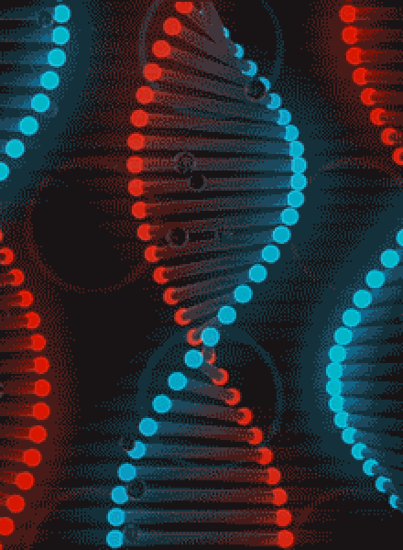
Learning Intentions
Probable frequencies of genotype and phenotype of offspring can be predicted using Punnett squares and by taking into consideration patterns of inheritance, including the effects of dominance

Slide 7
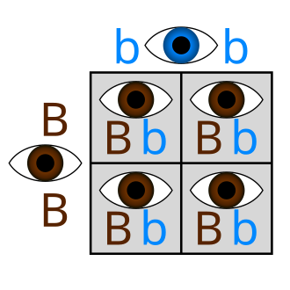
Success criteria
Define dominance in terms of alleles, inheritance patterns, genotype and phenotype.
Give examples of dominant and recessive traits.
Use Punnett squares to represent monohybrid crosses involving dominant-recessive traits.
This Photo by Unknown Author is licensed under CC BY-SA

Slide 8
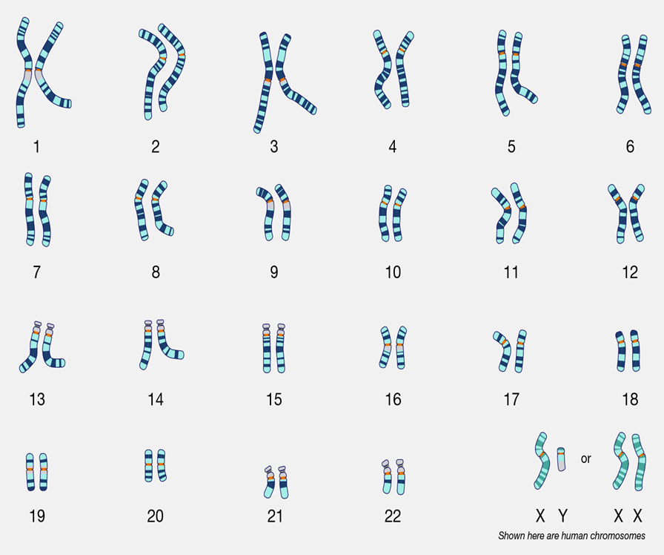
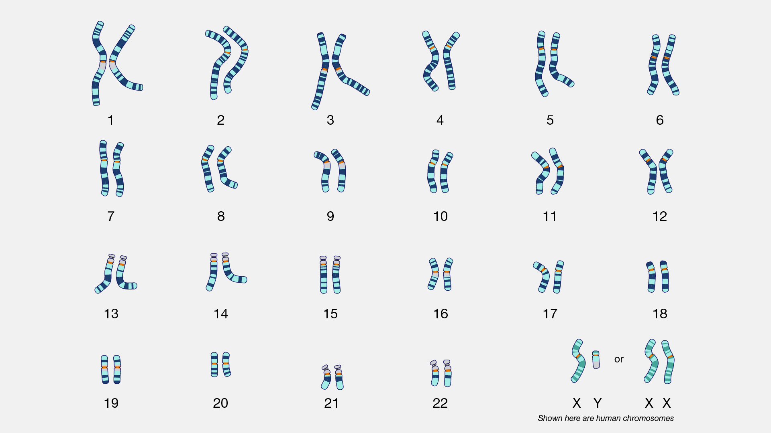
Patterns of inheritance
The complete diploid set of chromosomes is called the karyotype.
Humans have 46 chromosomes or 23 pairs of chromosomes.
This genome includes one set of genes from the egg and one set from the sperm.

Slide 9
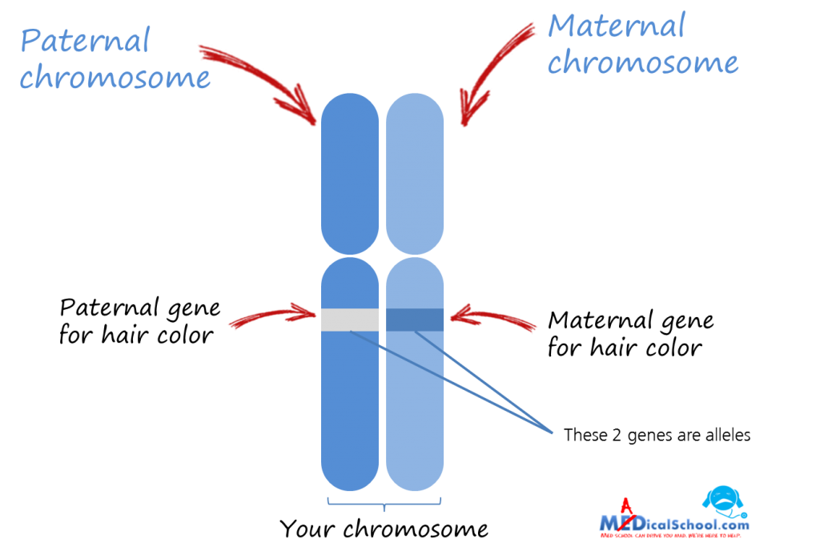
Patterns of inheritance
Since chromosomes are paired, the genes that they contain are also paired. Matched genes occur at the same locus on homologous chromosomes, and code for a particular trait.
Alternatives of the same trait are called alleles.
Brown
Blond

Slide 10
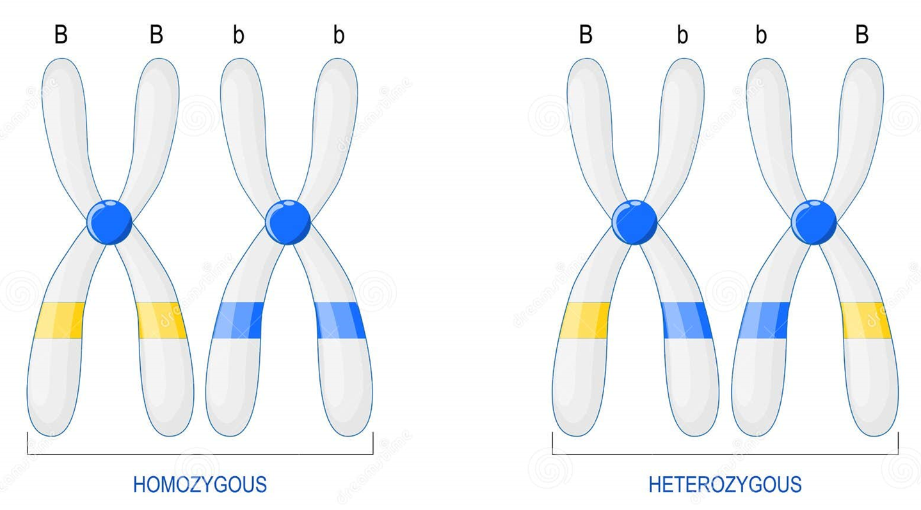

Patterns of inheritance
For any particular trait, when the two alleles are the same, the genotype is homozygous.
When the two alleles are different, the genotype is heterozygous.

Slide 11
Dominant alleles or traits
Dominant alleles will mask or suppress the expression of their recessive counterpart.
Phenotype describes which allele or trait is expressed.

Slide 12
Dominant alleles or traits
Dominant alleles will mask or suppress the expression of their recessive counterpart.
Phenotype describes which allele or trait is expressed.

Slide 13

Dominant alleles or traits
Dominant alleles will mask or suppress the expression of their recessive counterpart.

Slide 14
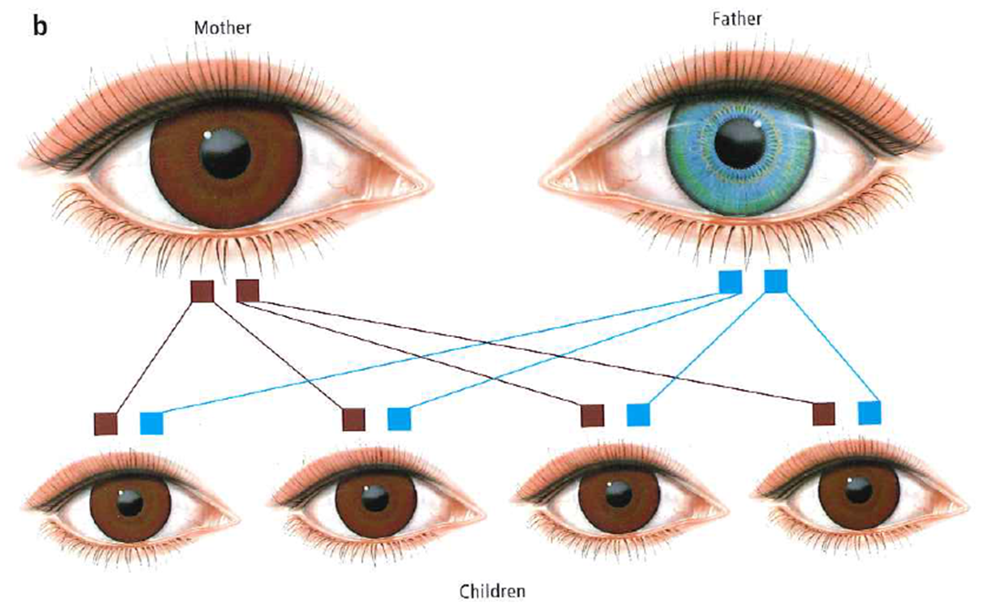

Slide 15
100% of offspring will have genotype Bb heterozygous 100% of offspring will have phenotype brown

Slide 16
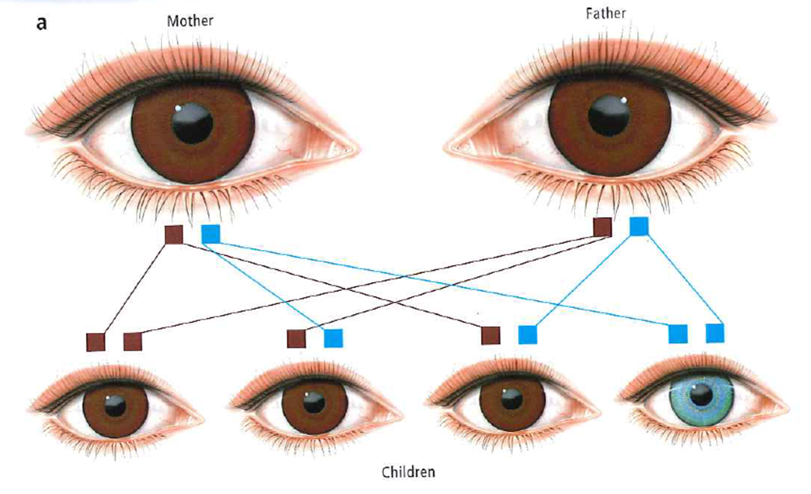

Slide 17
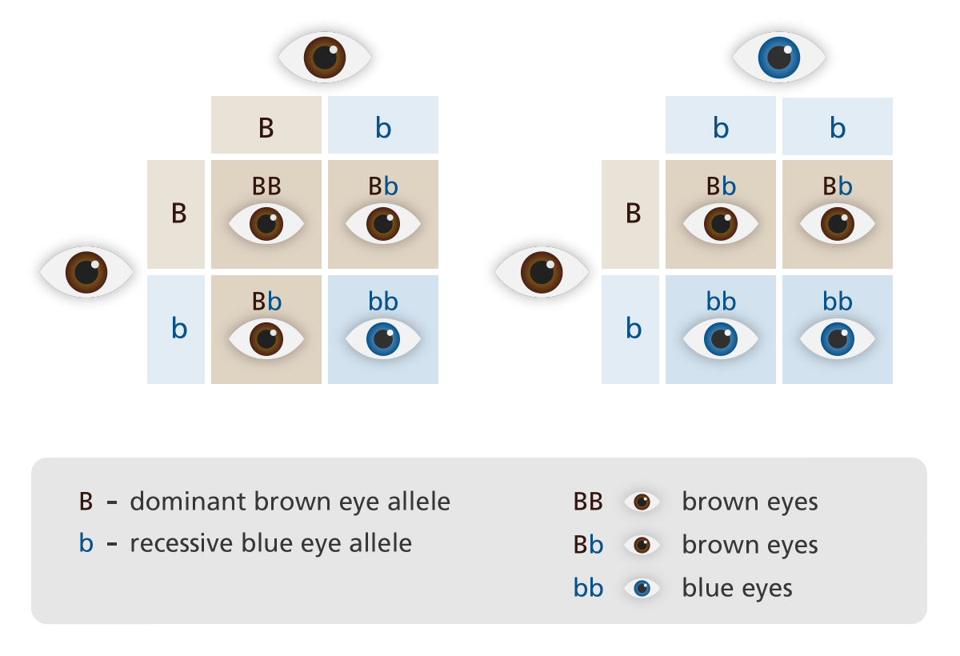
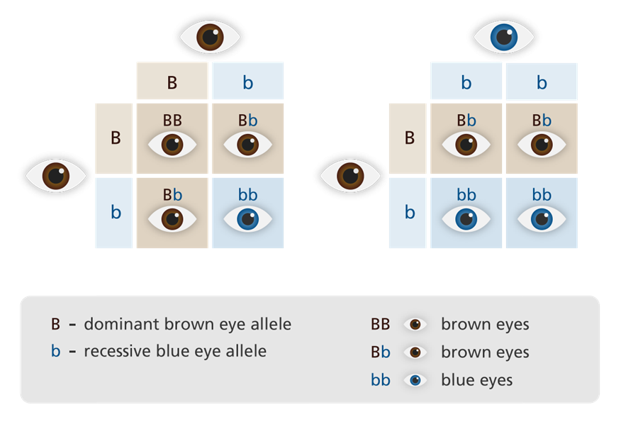

Slide 18
Genotypes:
Phenotypes:
25% BB homozygous brown
50% Bb heterozygous brown
25% bb homozygous blue
75% brown
25% blue

Slide 19
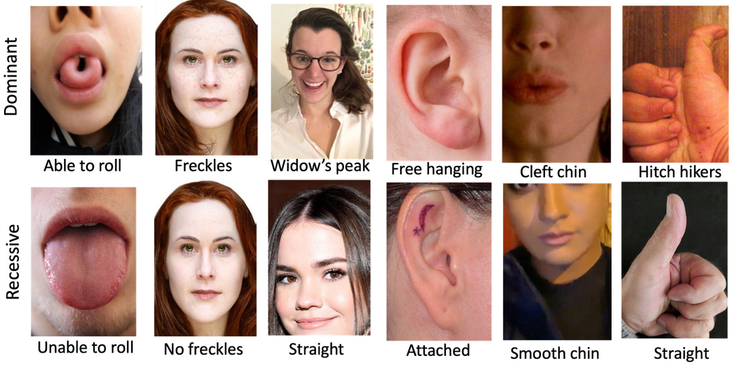

Slide 20
Success criteria
Define dominance in terms of alleles, inheritance patterns, genotype and phenotype.
Give examples of dominant and recessive traits.
Use Punnett squares to represent monohybrid crosses involving dominant-recessive traits.
This Photo by Unknown Author is licensed under CC BY-SA

